Slide 1
SKB-K18X001.00 Package Issue Improvement Plan
2021/1/5

Slide 2
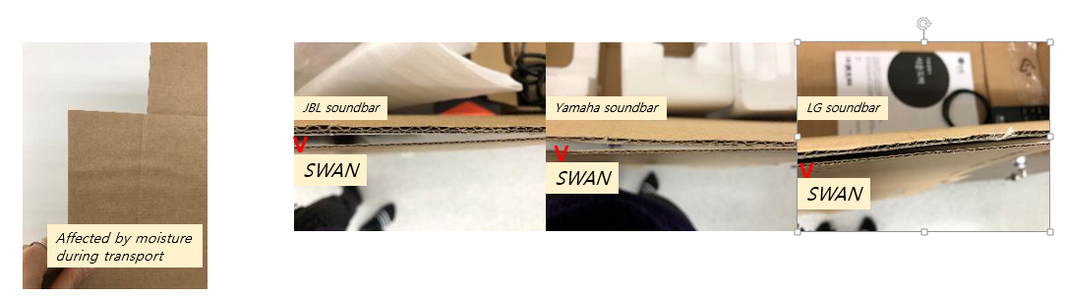
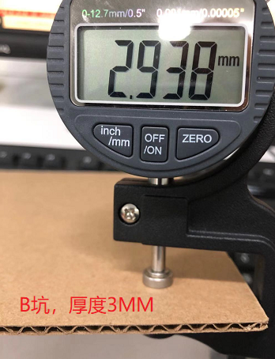
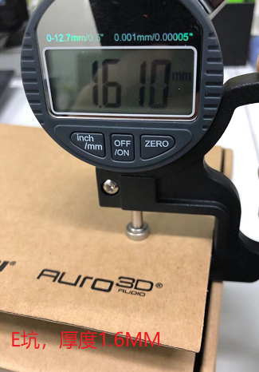
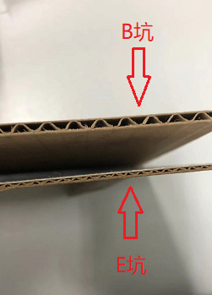
1. Thickness issue
Cause:
The spec is E flute and the international standard is 1.5-2MM
Improvement:
Customer can decide if need to change to B flute and the thickness will be 2.5-3MM.
B Flute
E Flute

Slide 3

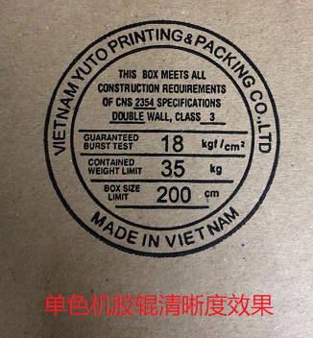
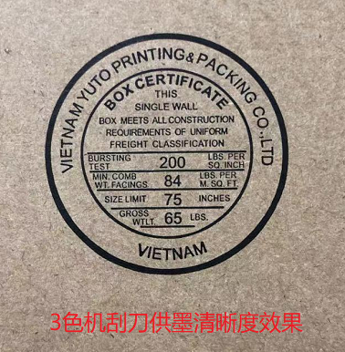
2. Printing issue
Cause:
This is due to the limit of water printing and the equipment.
Improvement:
Will improve by using the 3 color printing machine with the up-to-date ink handling system instead of the original single color printing machine.
Single color printing machine
3 color printing machine

Slide 4
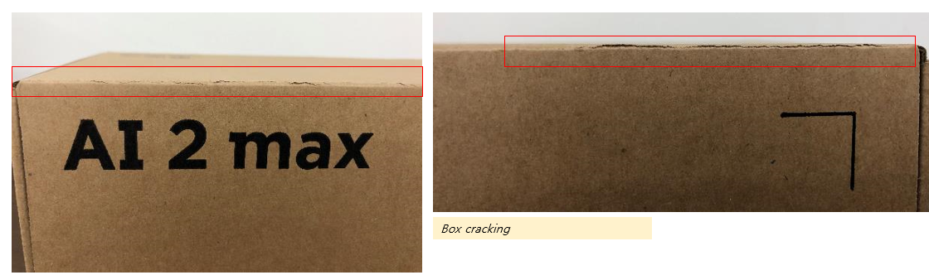
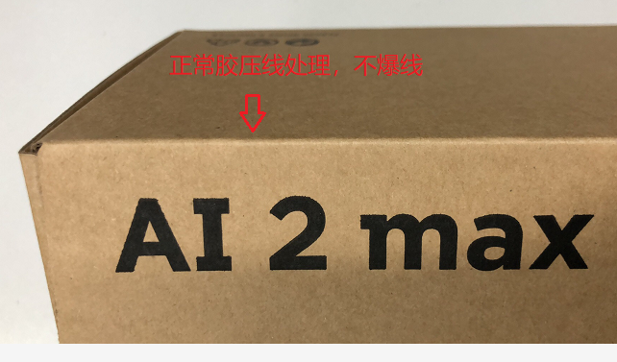
3. Cracked edge
Normal score line handling. The cracking issue is gone
Cause:
Caused by fast manufacturing for sample request and the score line was not handled well and resulted in uneven pressure. Plus the dry storage condition will cause the cracking.
Improvement:
Handle the score line well and even the pressure.

Slide 5
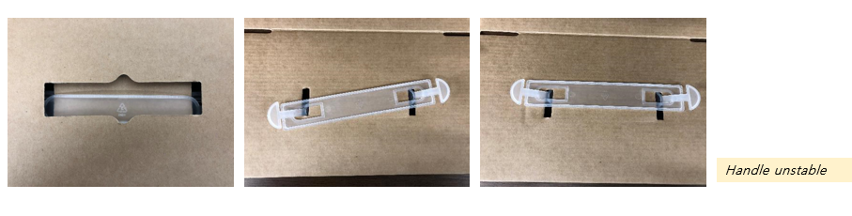
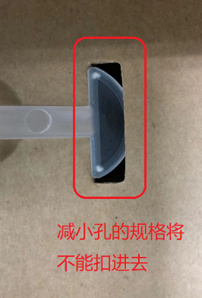
4. Unstable handles
Cause:
The shape of handle decides the size of penetrating hole which is a common application. If the holes are minimized to reduce the degree of shaking, the handle will not be able to pushed through the hole.
Improvement:
Current handle could hold the products well. From the design of inner plastic block, the handles will not fall of after installed.
Minimization of holes will impact the assembly of handles.
Notes:
請供應商解釋不會鬆脫

Slide 6
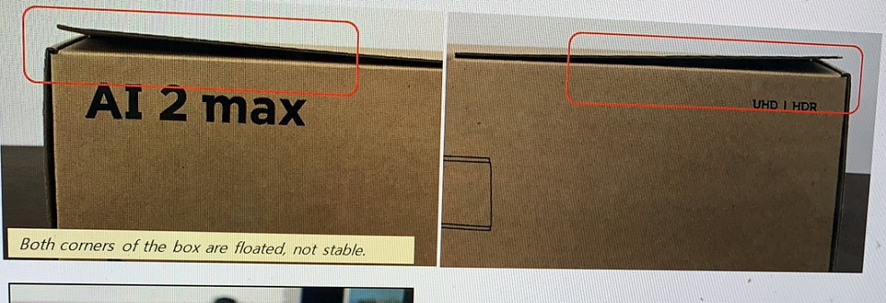
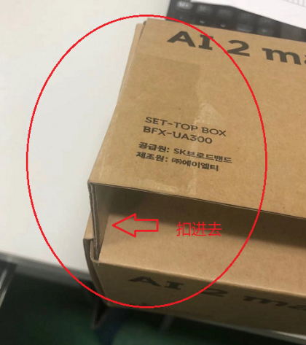
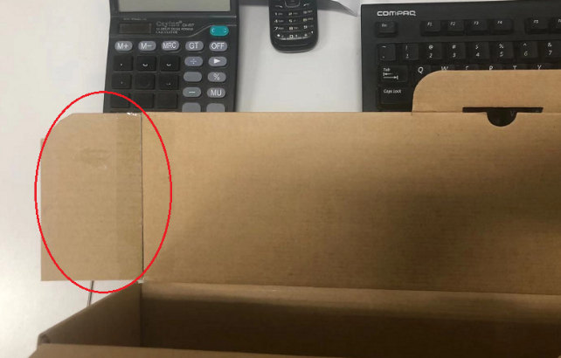
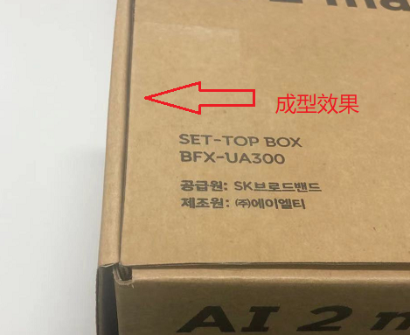
5. Warped edge
Cause:
The thickness of E flute applied on the design of wide area can easily cause the warped edge.
Improvement:
As customer advised, the wings are added and proved to be effective by experiment.
Notes:
B坑+wing

Slide 7
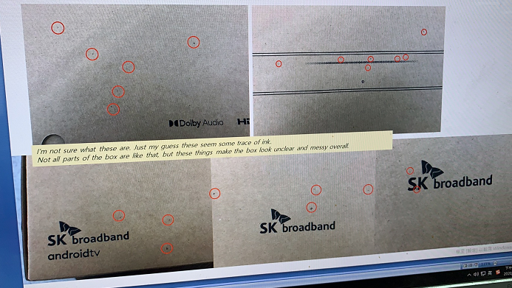
6. Black dots on the surface
Cause:
The kraft paper usually has this feature of dots on the surface.
Improvement:
We can filter out those with dots larger than 3mm. Or the customer could define the spec for the factory to do the filtering.
If the dots must not be seen, then we will have to purchase the advanced pure pulp which will increase the cost a lot.
Notes:
保證斑點小於3mm
用B坑的話無法保證雜質
E坑可以再加一層紙

